Slide 1
BRITISH AIRWAYS
PREDICTING CUSTOMER BUYING BEHAVIOR

Slide 2
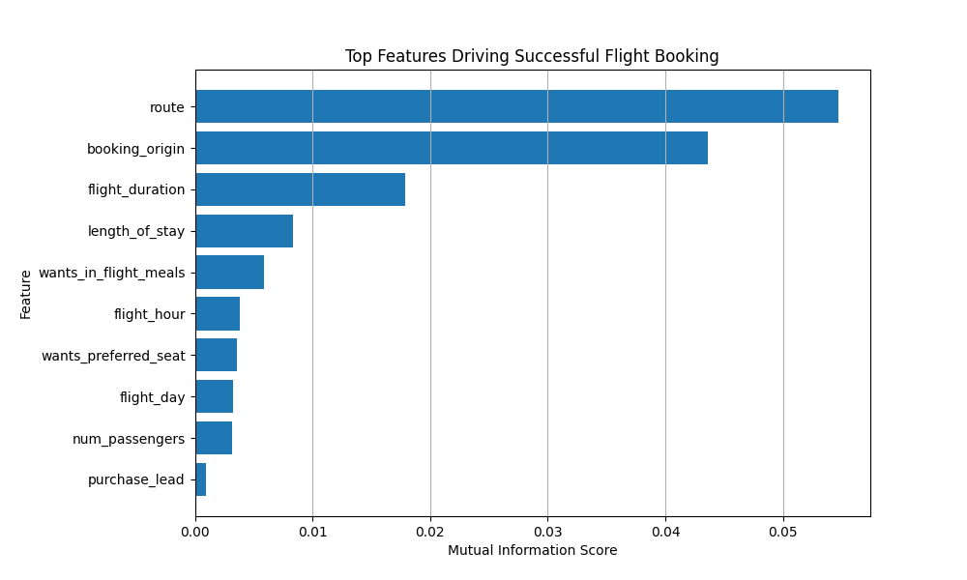
PREDICTIVE MODEL TO UNDERSTAND FACTORS THAT INFLUENCE BUYING BEHAVIOUR
We have trained the data set with Random forest classifier model and received:
ACCURACY: 85.62
AUC score: 0.549
Top features which influence Customer buying behavior:
purchase_lead
route
flight_hour
length_of_stay
booking_origin
flight_day
flight_duration
num_passengers
wants_in_flight_meals
wants_preferred_seat

